Slide 1
NEURAL NETWORKS

Slide 2
Neural networks
Why do we need AI or artifical neural networks?
Computers can solve several poblems: graph-related problems (shortest path algorithms, spanning trees), sorting arrays or any kind of optimization problems // numerical methods
BUT there are other problems → that can not be defined with an exact mathematical algorithm
For example: facial recognition, language processsing ...
OK but for humans these problems seems much more easier than graph algorithms or solving differential equations with Runge-Kutta methods …

Slide 3
Neural networks
INTUITION: if we try to mimic how nervous system of a human works or how a human learns things → maybe we are able to achive these problems with computers as well
Basically this is why AI has came to be → we came to the conclusion that for several problems the orthodox approach is not feasible
This is how big data has came to be as well → we have huge datasets and the way we handled datasets in the past (relational databases) is not going to work this time

Slide 4
Neural networks
Inspired by biological neural networks
We represent each neuron with a node → it is basically a directed / undirected graph
Their design enables them to process information in a similar way to our own biological brains
Each edge has a weight
These neural networks are capable of learning by changing the weights of their connections !!!
Support vector machines and other simpler methods ( linear classifiers ) gradually overtook neural networks in machine learning popularity
With the advent of deep learning neural nets are becoming more and more popular again

Slide 5
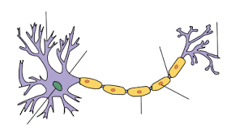
Neuron: neurons are the unit which the brain uses to process information
~ each neuron can make contact with several thousand other neurons
Neuron
Axon: transmit the electric signal from neuron
to neuron ~ basically connects the neurons !!!

Slide 6
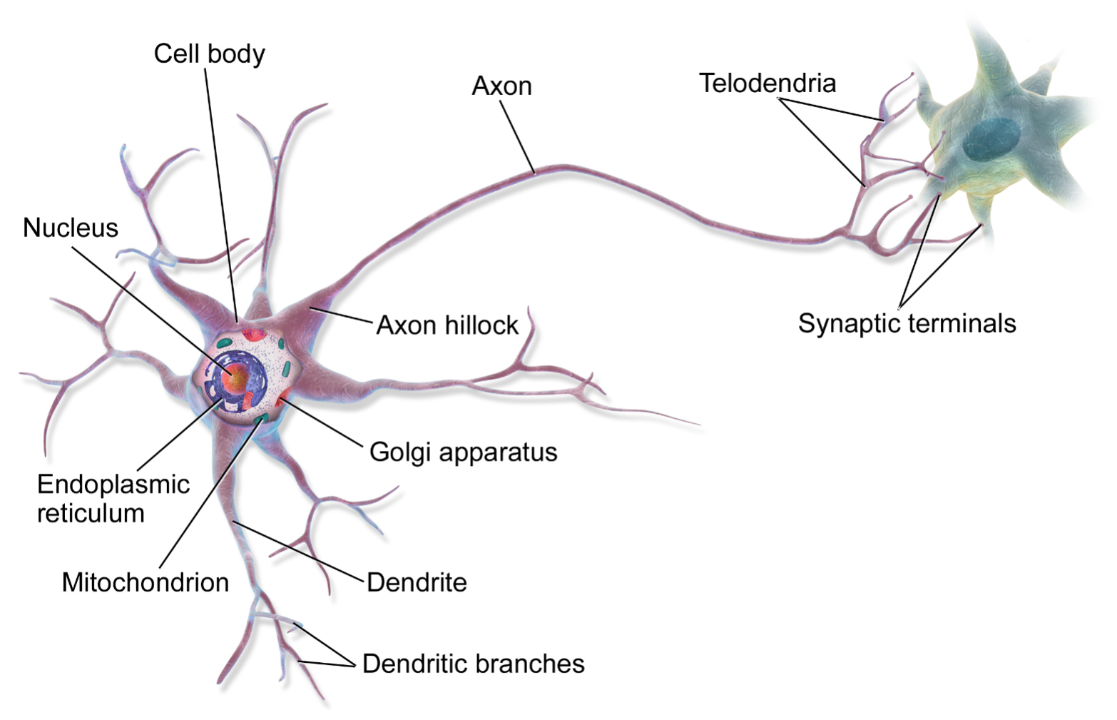
The boundary of the neuron is the so called cell membrane.
There is a voltage difference (the membrane potential) between
the inside and outside of the membrane
If the input is large enough, an action potential is then generated → with the help of the axon it can
reach several other neurons

Slide 7
Neurons only fire when input is larger than a given threshold
Important → firing doesn't get bigger as the stimulus increases,
its an all or nothing arrangement

Slide 8
Huge network of neurons and axons
INPUT
OUTPUT

Slide 9

We would like to construct an
algorithm that can conclude: it is
the number 7 !!!
This is the handwritten image we
want to recognize !!!
The approach is the same when we would like to recognize pedestrians while
driving or digitalize a handwritten book/article !!!

Slide 10
Neurons only fire when input is larger than a given threshold
Important → firing doesn't get bigger as the stimulus increases,
its an all or nothing arrangement
?
INPUT
OUTPUT

Slide 11
?
INPUT
OUTPUT
Model of nervous system → it is basically a graph with nodes ( neurons )
and the edges ( axons )

Slide 12
Model

Slide 13
Model
input layer

Slide 14
Model
hidden layer

Slide 15
Model
output layer

Slide 16
Input layer: we keep feeding our network with data through the
input layer
~ for example we have an image of a digit: we convert it to
RGB values so every pixel will have a numerical value.
So we have as many input neurons as the number of pixels in the image
Hidden layer: it is needed in order to make predictions when we
have non-linear problems
Output layer: we have the result here ~ the predicted digit

Slide 17
What is the input and the output?
?
INPUT
OUTPUT
For humans: we see a handwritten character → this is the input
Then we can recognize that character → that’s the output
For computers: of course we have to transform the image into numerical data, we
have to make a prediction what character it might be !!!

Slide 18
When to use neural networks?
Several problems can be solved with well defined algorithms: sorting numbers, multiplication, addition ...
Some problems can not be easily defined with an exact algorithm: facial recognition or OCR !!!
Most of the problems we try to solve with neural networks are quite trivial to humans

Slide 19
Learning paradigms

Slide 20
Supervised learning
The dataset we have has labels
So we know what results we are looking for
We train the network until we get the good results
For example: face recognition

Slide 21
AND logical relation
x
y
x AND y
0
0
0
0
1
0
1
0
0
1
1
1

Slide 22
Unsupervised learning
The dataset we have is not labeled
So we do NOT know what results we are looking for
The algorithm will figure out the pattern for us
For example: clustering algorithms

Slide 23
x
1
x
2

Slide 24
x
1
x
2

Slide 25


Model
inputs
x1
weights
neurons
„perceptrons”
w1
x2
w2
activation
function
w3
$$Σ$$
$$f$$
x3
sum
function
.
.
.
wn
xn

Slide 26
Model
inputs
x1
weights
neurons
„perceptrons”
w1
x2
w2
activation
function
w3
$$Σ$$
$$f$$
x3
sum
function
.
.
.
wn
xn

Slide 27
Model
2.) sum up
the weights
3.) activation function gives
the output !!!
1.) we have the incoming
weights

Slide 28
Model
What are the edge weights good for?
They can amplify or deamplify the input signal
> 1 amplify
< 1 deamplify
inputs
x1
weights
neurons
„perceptrons”
w1
x2
w2
activation
function
w3
$$Σ$$
$$f$$
x3
sum
function
.
.
.
wn
xn

Slide 29

Model
Sum function: we have to multiply each input
with the given edge weight and have to add these
values together
inputs
x1
$$\sum_{i=0}^{n}{xi ∗wi}$$
weights
neurons
„perceptrons”
sum =
w1
x2
w2
activation
function
w3
$$Σ$$
$$f$$
x3
sum
function
.
.
.
wn
xn

Slide 30
Model
Activation function: going to convert the
output (sum). A step function activation
function will output 1 if the input is higher
than a certain threshold ... 0 otherwise
inputs
x1
weights
neurons
„perceptrons”
w1
x2
w2
activation
function
w3
$$Σ$$
$$f$$
x3
sum
function
.
.
.
wn
xn

Slide 31
Percepton: it is a neuron in the neural network
We have to sum up the weighted inputs
For perceptrons we use the step function with a
given threshold
~ it is not working fine for neural network training because
the output can be 0 or 1 for perceptrons
A small change in the weights or bias of any single perceptron in the network
can sometimes cause the output of that perceptron to completely flip ( 0 → 1 )
That flip may then cause the behaviour of the rest of the
network to completely change in some very complicated way
Sigmoid neuron: very similar to perceptrons
But small changes in the edge weights → cause small change
in the output // no flips here !!!
~ the inputs / outputs can take any values between 0 and 1 !!!

Slide 32
We have to apply one of these
activation functions on the sum we have
calculated previously !!!
y = sign(x)
y
+1
x
-1
„STEP FUNCTION”

Slide 33
We have to apply one of these
activation functions on the sum we have
calculated previously !!!
y = sign(x-a)
y
+1
a
x
-1
„STEP FUNCTION”

Slide 34
We have to apply one of these
activation functions on the sum we have
calculated previously !!!
y = sign(x)
y
+1
0
x
„STEP FUNCTION”

Slide 35
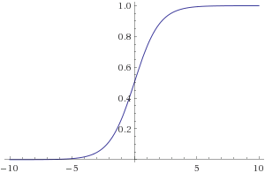
We have to apply one of these
activation functions on the sum we have
calculated previously !!!
1
y =
- x
1 + e
„SIGMOID FUNCTION”
The sigmoid function. The problem is that it does not have any negative value

Slide 36
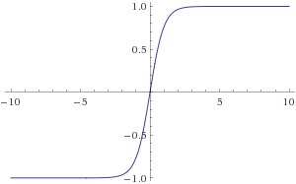
Hyperbolic tangent function
x
- x
e
- e
y =
x
- x
e
+ e
Sometimes it is better because it
can have negative values as well
„TANH FUNCTION”

Slide 37
The big picture

Slide 41
The information is encoded in the edge weights !!!

Slide 42
The information is encoded in the edge weights !!!
~ change in the edge weight → change in the output
w + Δw
o + Δo

Slide 43
The information is encoded in the edge weights !!!
~ change in the edge weight → change in the output
w + Δw
o + Δo
The algorithm keeps changing the edge weights → so that for the given inputs there
will be the right output in the output layer !!!

Slide 44
on every iteration the network gets a little closer to
be able to classify for example digits
we repeat the process several times: changing the weights
will produce better and better results
The network is learning !!!

Slide 45
Example
x1 = 1
w1 = 0.2
step function
w2 = - 0.5
$$Σ$$
$$f$$
x2 = 1
sum
function
w3 = 0.4
x3 = 0

Slide 46
Example
sum = x1*w1 + x2*w2 + x3*w3 = 1*0.2 + 1*(-0.5) + 0*0.4 = -0.3
stepFunction( -0.3 ) = 0 !!!
x1 = 1
w1 = 0.2
step function
w2 = - 0.5
$$Σ$$
$$f$$
x2 = 1
sum
function
w3 = 0.4
x3 = 0

Slide 47
Example
sum = x1*w1 + x2*w2 + x3*w3 = 1*0.2 + 1*(-0.5) + 0*0.4 = -0.3
stepFunction( -0.3 ) = 0 !!!
x1 = 1
w1 = 0.2
step function
w2 = - 0.5
$$Σ$$
$$f$$
0
x2 = 1
sum
function
w3 = 0.4
x3 = 0

Slide 48
Example
sum = x1*w1 + x2*w2 + x3*w3 = 1*0.2 + 1*0.5 + 1*0.7 = 1.4
stepFunction( 1.4 ) = 1 !!!
x1 = 1
w1 = 0.2
step function
w2 = 0.5
$$Σ$$
$$f$$
1
x2 = 1
sum
function
w3 = 0.7
x3 = 1

Slide 49
Applications of neural networks
Self driving cars + cars that are able to park themself without human intervention
Pattern recognition in healtcare industry → detect cancer or eye disorders well in advance
Pattern detection in stock markets in order to predict stock prices
Facial recognition
Natural language processing
In the united arab emirated AI has been used to control traffic → a system has been created that intelligently calculates traffic mishaps while consistently finding solutions to fix them

Slide 50
Feedforward neural network

Slide 51
Feedforward neural network
x
O
y
Output layer
Input layer
Hidden layer

Slide 52
x
y
Input layer
Output layer

Slide 53
x
Every node has a threshold T
If the incoming signal > T → the neuron
will fire !!!
w1
y
w2
Input layer
Output layer

Slide 54
AND logical relation
x
y
x AND y
0
0
0
0
1
0
1
0
0
1
1
1

Slide 55
x
Every node has a threshold T
If the incoming signal > T → the neuron
will fire !!!
w1
T=2
y
w2
Input layer
Output layer

Slide 56
x
w1 = 1.5
T=2
y
w2 = 1.5
Input layer
Output layer

Slide 57
When x=0 AND y=0 → the result should be 0
x=0
w1 = 1.5
T=2
y=0
w2 = 1.5
Input layer
Output layer

Slide 58
When x=0 AND y=0 → the result should be 0
x=0
w1 = 1.5
T=2
y=0
w2 = 1.5
Input layer
Output layer
Incoming signal to the output node: from x and from y
incomingSignal = xValue * w1 + yValue*w2
if ( incomingSignal > T ) → neuron will fire / produce a 1 !!!

Slide 59
When x=0 AND y=0 → the result should be 0
x=0
w1 = 1.5
T=2
y=0
w2 = 1.5
Input layer
Output layer
incomingSignal = 0*1.5 + 0*1.5 = 0

Slide 60
When x=0 AND y=0 → the result should be 0
x=0
w1 = 1.5
0
T=2
y=0
w2 = 1.5
Input layer
Output layer
incomingSignal = 0*1.5 + 0*1.5 = 0

Slide 61
When x=1 AND y=0 → the result should be 0
x=1
w1 = 1.5
0
T=2
y=0
w2 = 1.5
Input layer
Output layer
incomingSignal = 1*1.5 + 0*1.5 = 1.5

Slide 62
When x=0 AND y=1 → the result should be 0
x=0
w1 = 1.5
0
T=2
y=1
w2 = 1.5
Input layer
Output layer
incomingSignal = 0*1.5 + 1*1.5 = 1.5

Slide 63
When x=1 AND y=1 → the result should be 1
x=1
w1 = 1.5
1 !!!
T=2
y=1
w2 = 1.5
Input layer
Output layer
incomingSignal = 1*1.5 + 1*1.5 = 3

Slide 64
Optimization

Slide 65
Optimization
We usually use x to denote training inputs
x = ( x , x … x )
We denote the corresponding desire outputs by y = f(x)
For example: AND logical operator training data
1
2
n

Slide 66
AND logical relation
x
y
x AND y
0
0
0
0
1
0
1
0
0
1
1
1

Slide 67
Optimization
We usually use x to denote training input
x = ( x , x … x )
We denote the corresponding desire output by y = f(x)
For example: AND logical operator training data
1
2
n
--------------------------------------------------------------------------------------------------------------
In a neural network → we keep changing the edge weights so that the
output from the network approximates f(x)
We can measure how we are achieving the goal of
this approximation with a cost function

Slide 68

Optimization
2
C(w) = $\frac{1}{2n}$$\sum_{x}{|\left|f\left(x\right)−y^{′}\right||}$
- y’ is the output from the neural network
f(x) is the output we know from the training data
this is a so-called cost function → mean squared error !!!
What is the intuition?
~ if C(w) is huge → it means there are huge errors in the sense that our
neural network does not produce the results we know from the dataset
~ if C(w) is low → it means the neural network is making good predictions
WE HAVE TO FIND THE MINIMA FOR THE COST FUNCTION !!!

Slide 69
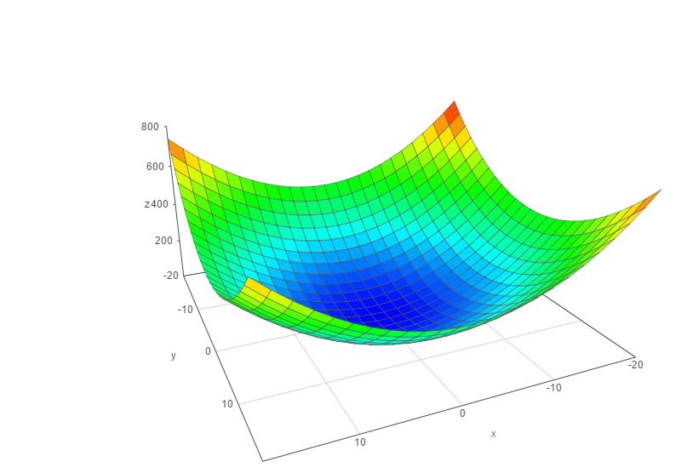
min C( w , w ... w )
w
1
2
n
w
1
w
2

Slide 70



How to find the minima of the cost-function?
1.) gradient descent
We have to know the partial derivative of the mean-squared error
and go to the direction of the gradient
// gradient ~ partial derivative
2.) backpropagation
It is a gradient descent implementation as well
~ the cost function can be defined as the average of all
the cost functions
// we assign a cost-function to every single training example
~ the cost function can be transformed into a form that it will be a function
of the output activations
$$\frac{∂MSE}{∂w}$$
$$\frac{∂MSE}{∂w}$$
$$\frac{∂MSE}{∂w}$$
…
1
2
n

Slide 71
Training our AND neural network

Slide 72
AND logical relation
x
y
x AND y
0
0
0
0
1
0
1
0
0
1
1
1

Slide 73
XOR logical relation
x
y
x XOR y
0
0
0
0
1
1
1
0
1
1
1
0

Slide 74
x
w1
y
w2
Problem: we do not know the correct edge weights in advance
We initialize it with a random number

Slide 75
x
w1 = 2
T=2
y
w2 = 3

Slide 76
x
y
x AND y
x
w1 = 2
0
0
0
0
1
0
T=2
1
0
0
1
1
1
y
w2 = 3
„ideal”

Slide 77
x
y
x AND y
0
0
0
x
y
x AND y
0
1
1
x
1
0
1
w1 = 2
0
0
0
1
1
1
0
1
0
T=2
1
0
0
„actual”
1
1
1
y
w2 = 3
„ideal”
incomingSignal = sum ( neuronValue * weight )

Slide 78
x
w1 = 2
T=2
y
w2 = 3

Slide 79
We construct the training data from out AND logical table. We have 4 (x,y) pairs with
the right answer: we can train out network according to these data
x
w1 = 2
T=2
y
w2 = 3

Slide 80
If (x,y) is (0,0) the correct answer is 0. We test it on our network: there will be probably
an error due to the random weights !!!
X=0
w1 = 2
T=2
y=0
w2 = 3

Slide 81
If (x,y) is (0,0) the correct answer is 0. We test it on our network: there will be probably
an error due to the random weights !!!
X=0
w1 = 2
T=2
y=0
w2 = 3
incomingSignal = 0*2 + 0*3 = 0
Expected according to the logic table: 0
Result: 0
Error: 0

Slide 82
Error calculation
The simplest algorithm: error = rightAnswer – calculatedAnswer
Better approach: ( rightAnswer – calculatedAnswer )
We run our algorithm until theses error terms are very small !!!
We keep updating the edge weights
weight(n+1) = weight(n) + input * error * learningRate ( < 1 )
2

Slide 83
If (x,y) is (1,0) the correct answer is 0. We test it on our network: there will be probably
an error due to the random weights !!!
X=1
w1 = 2
T=2
y=0
w2 = 3
incomingSignal = 1*2 + 0*3 = 2
Expected according to the logic table: 0
Result: 1 // because incomingSignal >= T
Error: 0-1 = -1

Slide 84
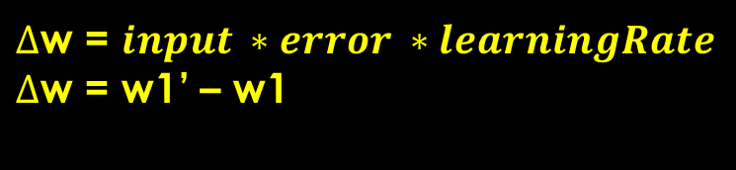
We have to update the weight !!!
w1’ = w1 + 1 * (-1) * 0.1
w2’ = w2 + 0 * (-1) * 0.1
$∆$w = $input ∗error ∗learningRate$
$∆$w = w1’ – w1
X=1
w1 = 2
T=2
y=0
w2 = 3
incomingSignal = 1*2 + 0*3 = 2
Expected according to the logic table: 0
Result: 1 // because incomingSignal >= T
Error: 0-1 = -1

Slide 85
We have to update the weight !!!
w1’ = w1 + 1 * (-1) * 0.1
w2’ = w2 + 0 * (-1) * 0.1
X=1
w1 = 1.9
T=2
y=0
w2 = 3
incomingSignal = 1*2 + 0*3 = 2
Expected according to the logic table: 0
Result: 1 // because incomingSignal >= T
Error: 0-1 = -1

Slide 86
Output layer
Input layer
Hidden layer

Slide 87
x
y

Slide 88
1
1
x
y
We always need a bias ( with value 1 ): to be able to control the output

Slide 89
Bias unit
Sometimes we want to get not zero output even if the inputs are all zeros. Basically
we can shift the activation function with bias units

Slide 90
1
1
w1
w10
w2
w3
w11
x
w4
w5
w6
w12
w7
y
w8
w9
w13
We always need a bias ( with value 1 ): to be able to control the output

Slide 91
1
1
1
1
1
2
x
2
1.5
1
-2.5
2
0.5
y
2
1
1.5

Slide 92
1
1
1
A
1
1
2
x
2
1.5
1
-2.5
B
2
0.5
y
2
1
C
1.5
How we are able to compute the values for A, B, C? We have to sum up the neuron values
multiply by the edge weights accordingly !!!

Slide 93
1
1
1
A
1
1
2
x
2
1.5
1
-2.5
B
2
0.5
y
2
1
C
1.5

Slide 94
1
1
1
A
1
1
2
x
2
1.5
1
-2.5
B
2
0.5
y
2
1
C
1.5
tempA = biasNode*biasWeight + xValue * xWeightToA + yValue*yWeightToA

Slide 95
1
1
1
A
1
1
2
X=1
2
1.5
1
-2.5
B
2
0.5
Y=0
2
1
C
1.5
tempA = 1*1 + 1*2 + 0*0.5 = 3

Slide 96
We have to use activation functions to calculate the activation
level of the neurons: it yields whether the given neuron will fire or not !!!

Slide 97
1
1
1
A
1
1
2
X=1
2
1.5
1
-2.5
B
2
0.5
Y=0
2
1
C
1.5
tempA = 1*1 + 1*2 + 0*0.5 = 3 → sign(tempA) = +1 !!!

Slide 98
1
1
1
A=1
1
1
2
X=1
2
1.5
1
-2.5
B
2
0.5
Y=0
2
1
C
1.5
tempA = 1*1 + 1*2 + 0*0.5 = 3 → sign(tempA) = +1 !!!

Slide 99
1
1
1
A=1
1
1
2
X=1
2
1.5
1
-2.5
B
2
0.5
Y=0
2
1
C
1.5
tempB = bias * biasWeight + xValue * xWeightToB + yValue * yWeightToB

Slide 100
1
1
1
A=1
1
1
2
X=1
2
1.5
1
-2.5
B
2
0.5
Y=0
2
1
C
1.5
tempB = 1 * 2 + 1 * 1 + 0 * 2 = 3

Slide 101
1
1
1
A=1
1
1
2
X=1
2
1.5
1
-2.5
B=1
2
0.5
Y=0
2
1
C
1.5
tempB = 1 * 2 + 1 * 1 + 0 * 2 = 3 → sign(tempB) = +1

Slide 102
1
1
1
A=1
1
1
2
X=1
2
1.5
1
-2.5
B=1
2
0.5
Y=0
2
1
C
1.5
tempB =bias * biasWeight + xValue * xWeightToC + yValue * yWeightToC

Slide 103
1
1
1
A=1
1
1
2
X=1
2
1.5
1
-2.5
B=1
2
0.5
Y=0
2
1
C
1.5
tempB = 1 * 1,5 + 1 * (-2.5) + 0 * 1 = -1

Slide 104
1
1
1
A=1
1
1
2
X=1
2
1.5
1
-2.5
B=1
2
0.5
Y=0
2
1
C=-1
1.5
tempB = 1 * 1,5 + 1 * (-2.5) + 0 * 1 = -1 → sign(tempC) = -1

Slide 105
1
1
1
A=1
1
1
2
X=1
2
1.5
1
-2.5
B=1
2
0.5
Y=0
2
1
C=-1
1.5

Slide 106
1
1
1
A=1
1
1
2
X=1
2
1.5
1
-2.5
B=1
2
0.5
Y=0
2
1
C=-1
1.5
tempOutput = biasValue * biasWeight + valueA * weightA + ...

Slide 107
1
1
1
A=1
1
1
2
X=1
2
1.5
1
-2.5
B=1
2
0.5
Y=0
2
1
C=-1
1.5
tempOutput = 1 * 1 + 1 * 1 + 1 * 2 + (-1) * 1.5 = 2.5

Slide 108
1
1
1
A=1
1
1
2
X=1
2
1.5
1
-2.5
B=1
2
+1
0.5
Y=0
2
1
C=-1
1.5
tempOutput = 1 * 1 + 1 * 1 + 1 * 2 + (-1) * 1.5 = 2.5 → sign(tempOutput) = +1

Slide 109
y
x

Slide 110
y
x

Slide 111
We have trainig data: (x,y) pairs + whether it is under the line
or not
y
x

Slide 112
y
x

Slide 113
After training our neural network: if we have a (x,y) pair, we can predict
whether it is under the line or not
y
x

Slide 114
Single-layer network:
If we have a linearly separable problem
~ a single-layer network is fine
Multi-layer network:
If we have a non-linear classification problem
~ we have to use multi-layer network

Slide 115
AND problem
XOR problem
y
y
1
0
0
1
1
0
1
0
0
0
0
1
x
x
0 1
0 1
This is a linearly separable problem,
no hidden layer needed
This is a non-linearly separable problem,
no linear line can be found to separate 0 from 1
Hidden layer needed in the network !!!!

Slide 116
The algorithm
1.) Initialize the edge weights at random
2.) Calculate the error: we have some training data and some results
x
y
x XOR y
The inputs are the (x,y) pairs: we
calculate the sum values and
acivation functions → we get a
value (output)
Output not always the ideal output
from the logical table !!!
// thats why we have errors
0
0
0
0
1
1
1
0
1
1
1
0
3.) Calculate the changes of the edge weights and update the weights. This is
the backpropagation process !!!
4.) The algorithm terminates when the network error is small

Slide 117
XOR problem
x
y

Slide 118
XOR problem
Initialize the weights at random
x
y

Slide 119
XOR problem
0.1
0.78
x
0.4
-0.22
0.5
0.35
y
-0.78
0.43
-0.4

Slide 120

XOR problem
We run our network on the
training data
0
$$\sum_{i=0}^{n}{xi ∗wi}$$
0.78
sum =
0.1
0
0.4
-0.22
0
0.5
0.35
0
-0.78
0.43
-0.4
0

Slide 121
XOR problem
We run our network on the
training data
0
$$\sum_{i=0}^{n}{xi ∗wi}$$
0.78
sum =
0.1
0
0.4
-0.22
0
0.5
0
0.35
0
-0.78
The output is 0.
the ideal value according
the table is 0 too
Error: 0 !!!
0.43
-0.4
0

Slide 122
XOR problem
We run our network on the
training data again
$$\sum_{i=0}^{n}{xi ∗wi}$$
0.78
sum =
0.1
0
0.4
-0.22
0.5
0.35
1
-0.78
0.43
-0.4

Slide 123
XOR problem
We run our network on the
training data again
1
$$\sum_{i=0}^{n}{xi ∗wi}$$
0.78
sum =
0.1
0
0.4
-0.22
0.5
0.35
1
-0.78
0.43
-0.4
sum = 0*0.1 + 1*0.35 = 0.35
stepFunction( 0.35 ) = 1

Slide 124
XOR problem
We run our network on the
training data again
1
$$\sum_{i=0}^{n}{xi ∗wi}$$
0.78
sum =
0.1
0
0.4
-0.22
0
0.5
0.35
1
-0.78
0.43
-0.4
sum = 0*0.4 + 1*(-0.78) = -0.78
stepFunction( -0.78 ) = 0

Slide 125
XOR problem
We run our network on the
training data again
1
$$\sum_{i=0}^{n}{xi ∗wi}$$
0.78
sum =
0.1
0
0.4
-0.22
0
0.5
0.35
1
-0.78
0.43
-0.4
1
sum = 0*(-0.22) + 1*(0.43) = 0.43
stepFunction( 0.43 ) = 1

Slide 126
XOR problem
We run our network on the
training data again
1
$$\sum_{i=0}^{n}{xi ∗wi}$$
0.78
sum =
0.1
0
0.4
-0.22
0
0.5
0
0.35
1
-0.78
0.43
-0.4
1
sum = 1*0.78 +0*0.5 + 1*(-0.4) = -0.38
stepFunction( -0.38 ) = 0

Slide 127
Run our neural net on
the training data
We get the calculated output
This is the forward process
( we have the ideal output because
it is a supervised learning method )
Update the edge weights accordingly
// calculate gradients, use
learning rate and momentum etc ...
Calculate the error term:
calculatedOutput - idealOutput

Slide 128
XOR problem
We run our network on the
training data again
0.35
$$\sum_{i=0}^{n}{xi ∗wi}$$
0.78
sum =
0.1
1
0.4
-0.22
-0.78
0.5
0
0.35
1
-0.78
0.43
Ideal: 1 ( from the table )
Calculated: 0
Error: not zero !!!
We have to update the weights
-0.4
0.43

Slide 129
Bias inputs are always 1 but the edge weights have random
values at the beginning and we have to update them accordingly
1
1
0.35
0.1
0.78
0
0.4
-0.22
-0.78
0.5
-0.29
0.35
1
-0.78
0.43
-0.4
0.43

Slide 130
Error calculation
Input idealOutput / trainingTarget actualOutput
0 0 0 0.3
0 1 1 0.2
1 0 1 0.4
1 1 0 0.5

Slide 131

Error calculation
Input idealOutput / trainingTarget actualOutput
0 0 0 0.3
0 1 1 0.2
1 0 1 0.4
1 1 0 0.5
$$\frac{1}{n}\sum_{i=1}^{n}{{(ideal\left(i\right)−actual\left(i\right))}^{2}}$$
Mean square error: „MSE”

Slide 132
Error calculation
Input idealOutput / trainingTarget actualOutput
0 0 0 0.3
0 1 1 0.2
1 0 1 0.4
1 1 0 0.5
Mean square error: „MSE”
${{{{\frac{1}{4} ( (0−0.3)}^{2}+(1−0.2)}^{2}+(1−0.4)}^{2}+(0−0.5)}^{2}$ )

Slide 133

Error calculation
Input idealOutput / trainingTarget actualOutput
0 0 0 0.3
0 1 1 0.2
1 0 1 0.4
1 1 0 0.5
$$\sqrt{\frac{1}{n}\sum_{i=1}^{n}{{(ideal\left(i\right)−actual\left(i\right))}^{2}}}$$
Root mean square error: „RMSE”

Slide 134

Error calculation
Input idealOutput / trainingTarget actualOutput
0 0 0 0.3
0 1 1 0.2
1 0 1 0.4
1 1 0 0.5
$=\sqrt{{\frac{1}{4}( {(0−0.3)}^{2}+(1−0.2)}^{2}+{(1−0.4)}^{2}{+(0−0.5)}^{\begin{aligned}2 \\ \end{aligned}}}$
it is the square root
of mean square error
„RMSE”
)

Slide 135
Gradient calculation
The problem with equations: f( w1, w2 ... wn ) = MSE
// if we change the weights the MSE will change too !!!
min C( w1, w2 ... wn ) C() measures the error !!!
w
Because we have several weights, the problem will be an optimization
problem in high dimensions
- brute force search for the optimal solution is not working
because of the enormous search space
- simulated annealing and genetic algorithms give us an
approximation ... which is good most of the time !!!

Slide 136
Gradient calculation
We have to calculate the gradient to know how much we
should adjust the edge weights
f(w) = MSE
w

Slide 137

Gradient calculation
We have to calculate the gradient to know how much we
should adjust the edge weights
MSE
we have to calculate
the slope of the curve
with partial derivatives
$$\frac{∂MSE}{∂w}$$
direction of
the gradient
w

Slide 138
Gradient calculation
For every node we have to calculate the so called delta parameter
// it is essential for getting the gradient
We need the deriative of the activation function
public double void sigmoid(double x){
return 1 / (1 +Math.exp(-x));
}
public double dSigmoid(double x){
return ( sigmoid(x)*(1-sigmoid(x)) );
}
1
y =
- x
1 + e
„sigmoid function”

Slide 139
Gradient calculation
Calculate the delta for the output layer:
deltaOutput = - E * dSigmoid(sum)
error
term
derivative of the
activation function
// sometimes the error term is defined differently
E = actual – ideal OR E = ideal - actual

Slide 140
Gradient calculation
Calculate the delta for the output layer:
deltaOutput = - E * dSigmoid(sum)
error
term
derivative of the
activation function
w1=-0.22
sum=-0.51
output=0.33
w2=0.15
sum=0.217
output=0.76

Slide 141
Gradient calculation
Calculate the delta for the output layer:
deltaOutput = - E * dSigmoid(sum)
error
term
derivative of the
activation function
w1=-0.22
sum=-0.51
output=0.33
sum = 0.33*(-0.22)+0.76*0.15 = 0.0414
output=sigmoid(sum)
ideal: should be 1 ( training data !!!! )
w2=0.15
sum=0.217
output=0.76

Slide 142

Gradient calculation
Calculate the delta for the output layer:
deltaOutput = - E * dSigmoid(sum)
error
term
derivative of the
activation function
w1=-0.22
sum=-0.51
output=0.33
sum = 0.33*(-0.22)+0.76*0.15 = 0.0414
output=sigmoid(sum) = 0.51
ideal: should be 1 ( training data !!!! )
w2=0.15
E = actual – ideal = 0.51 – 1 = -0.49
$δ=0.49 ∗dSigmoid\left(0.0414\right)=$0.49 * 0.249 = 0.122
sum=0.217
output=0.76

Slide 143

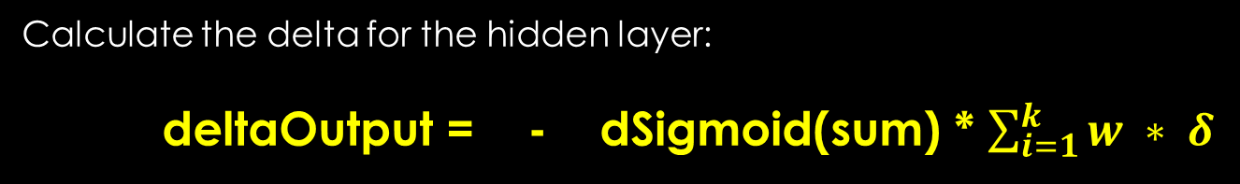

Gradient calculation
Calculate the delta for the hidden layer:
deltaOutput = - dSigmoid(sum) * $\sum_{i=1}^{k}{w ∗ δ}$
derivative of the
activation function
weights and the
previous layer delta
w1=-0.22
sum=-0.51
output=0.33
$δ=$0.122
w2=0.15
$δ$ = - dSigmoid(-0.51) * ( -0.22 * 0.122 ) = -0.234 * (-0.0268) =
= 0.006
sum=0.217
output=0.76

Slide 144
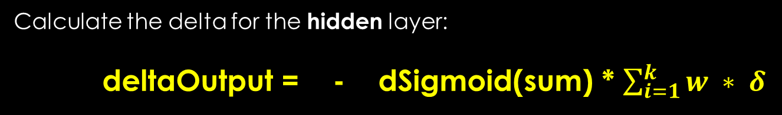
Gradient calculation
Calculate the delta for the hidden layer:
deltaOutput = - dSigmoid(sum) * $\sum_{i=1}^{k}{w ∗ δ}$
derivative of the
activation function
weights and the
pevious layer delta
w1=-0.22
sum=-0.51
output=0.33
$δ=$0.122
w2=0.15
$δ$ = - dSigmoid(-0.51) * ( -0.22 * 0.122 ) = -0.234 * (-0.0268) =
= 0.006
sum=0.217
output=0.76
IMPORTANT: we do not have to calculate the node deltas for
bias nodes and input nodes !!!

Slide 145


Gradient calculation
Calculate the gradients:
$$\frac{∂MSE}{∂w}$$
= $δ$
* input
derivative by edge weight
activation of
the neuron input
node delta at
the output node
Why is it good? BACKPROPAGATION !!!

Slide 146





Backpropagation
$∆$w
=
$α$
$$\frac{∂MSE}{∂w}$$
+$μ$ *
$∆$w
t
*
t-1
t
previous change
in edge weight from
previous iteration
change in edge weight
at time t
learning rate
momentum
gradient

Slide 147





Backpropagation
$∆$w
=
$α$
$$\frac{∂MSE}{∂w}$$
+$μ$ *
$∆$w
t
*
t-1
t
Learning rate: ~ 0.3
Define how fast our algorithm will learn
If it is too high: converge fast but not will be accurate, it may
miss global optimum
If it is too low: algorithm will be slow but more accurate !!!
Momentum: ~ 0.6
We can escape local minimas with this ( do not always work )
Define how much we are relying on the previous change, simply
adds a fraction of the previous weight update to the current one
High: helps to increase the speed of convergence of the system, but
it can overshoot the minimum
Too low: cannot avoid local optimums and slows down the training

Slide 148
Backpropagation

Slide 149
Backpropagation

Slide 150
Backpropagation

Slide 151
Backpropagation

Slide 152
Backpropagation

Slide 153
Backpropagation
This is the forward stage: we feed our neural net with the input data and
calculate the output !!!

Slide 154
Backpropagation

Slide 155
Backpropagation

Slide 156
Backpropagation

Slide 157
Backpropagation

Slide 158
Backpropagation

Slide 159
Backpropagation
This is the backward process: we update the edge weights starting
from the output layer !!!

Slide 160
Resilient propagation

Slide 161
Resilient propagation
It can be used to train neural networks as well
It has some advantages over backpropagation:
Usually faster than backpropagation
We do not have to specify extra parameters such as learning rate and momentum
Disadvantage: very hard to implement efficiently

Slide 162
Resilient propagation
It is an iterative approach as well: we have training epochs
Resilient propagation relies heavily on the gradients as well
The idea is that you must have some measure of error and that the value of the error will change as the value of one weight changes //assuming we hold the values of the other weights and biases the same

Slide 163
Resilient propagation
We have to calculate the gradient to know how much we
should adjust the edge weights
MSE
we have to calculate
the slope of the curve
with partial derivatives
$$\frac{∂MSE}{∂w}$$
direction of
the gradient
w

Slide 164
Resilient propagation
We have to calculate the gradient to know how much we
should adjust the edge weights
MSE
we have to calculate
the slope of the curve
with partial derivatives
$$\frac{∂MSE}{∂w}$$
direction of
the gradient
w

Slide 165
Resilient propagation
Negative slope: go in the positive weight direction
Positive slope: go in the negative weight direction
The steepness / magnitude of the slope: good hint how rapidly the
error is changing and how far to move to get a smaller MSE
MSE
we have to calculate
the slope of the curve
with partial derivatives
$$\frac{∂MSE}{∂w}$$
direction of
the gradient
w

Slide 166
Resilient propagation
Backprop: uses the magnitude to determine how to change the weights
Problem: the algorithm can overshoot the minimum
Oscillations occur !!! ~ missing the local optimum
OK we could use a smaller learning rate but the algorithms will
be slower !!!
MSE
we have to calculate
the slope of the curve
with partial derivatives
$$\frac{∂MSE}{∂w}$$
direction of
the gradient
w

Slide 167
Resilient propagation
Resilient propagation does not use the magnitude of the gradient to determine a weight delta
Instead it relies on the sign of the gradient ( + or - ) !!!
Instead of using a single learning rate for all weights and biases, resilient propagation uses separate weight deltas for each weight and bias and adapts these deltas during training

Slide 168
Applications of neural networks

Slide 169
Optical character recognition
We have an image and want to find out what character it is
Input layer:
For example we have a 8x8 pixel image ( 64 pixels )
In this situation we have 64 input neuron
Output layer
We have 26 output neurons because in the english alphabet there are 26 characters

Slide 171
new float[] {0,1,1,1,0,0,1,0,1,0,0,1,1,1,0,0,0,0,1,0,0,1,1,1,0};

Slide 172
We usually encode the output in binary
zero → 1 0 0 0 0 0 0 0 0 0
one → 0 1 0 0 0 0 0 0 0 0
two → 0 0 1 0 0 0 0 0 0 0
three → 0 0 0 1 0 0 0 0 0 0
four → 0 0 0 0 1 0 0 0 0 0
.
.
.

