Slide 1
MACHINE LEARNING
AND
NEURAL NETWORKS

Slide 2
Linear Regression
It is an approach for modelling the relationship between scalar dependent
variable y and one or more explanatory variables x
SIMPLE LINEAR REGRESSION MULTIPLE LINEAR REGRESSION
single explanatory variable x
we want to approximate the price
of houses if we know the sizes
several explanatory variables x
we want to approximate the price
of houses if we know the sizes,
number of rooms...
We use linear predictor functions: this is why it is called LINEAR regression

Slide 3
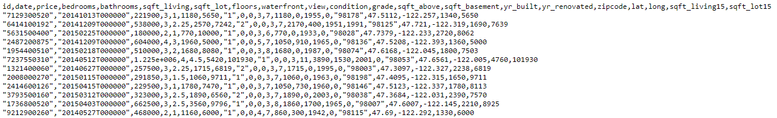
Linear Regression
Linear regression is the first machine learning algorithms: as usual it needs a dataset
Dataset: house_sales.csv
Contains information about a home sold between May 2014 and May 2015 along
with the price ~ multiple explanatory variables are present

Slide 4
Linear Regression
prices [$]
What is the aim of Linear Regression?
→ want to find some linear relationship
between the features
500
400
independent variable we use to
make predictions (size of house)
300
H(x) = b + b x
0
1
200
dependent variable, this is what we
are trying to predict or estimate
(price of the house)
100
2
size of houses [m ]
30
50
80
100

Slide 5
Linear Regression
prices [$]
So we build a model based on the dataset
It is a linear model: so the result is a linear line
→ the model defines the relationship
between the variables
→ we can make predictions with the
trained model
What does it mean? If we have a new x feature
(size of the house) we can get the H(x) price
of the house accordingly
500
400
300
200
100
2
size of houses [m ]
30
50
80
100

Slide 6
Linear Regression
we have a dataset (all machine learning algorithm needs one)
we train the algorithm: which means finding the linear relationship
between the H(x) and x variables
H(x) = b + b x
OPTIMIZATION !!!
0
1
after the training we have the b values which means
we can make predictions with the model
(for new datapoints)

Slide 7
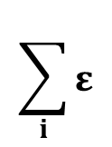
Linear Regression
ε
Mean Squared Error (MSE)
7
It is the difference between the y actual values present in the
dataset (supervised learning) and the H(x) values
predicted by the model
ε
ε
8
4
ε
ε
5
6
ε
ε
2
1
3
[ H(x) – y ]
„cost-function”
ε
2
if this term is small (small error): it means the model
predictions are very close to the actual values GOOD
$$\sum_{i}{ε}$$
if this term is big (huge error): it means the model
predictions differ from the actual values BAD
MSE =
2
i

Slide 8

Linear Regression
OPTIMIZATION PROBLEM
This is why optimization algorithms are so important
~ no matter what problem we are dealing with, finally we have to use
some optimization methods to solve it
this is the prediction from
our linear model (linear regression)
min ${[H\left(x\right)−y]}^{2}$
b
we want to find the minimum by
tuning these parameters
this is the value we know from
the training data
// supervised learning !!!

Slide 9

Linear Regression
OPTIMIZATION PROBLEM
This is why optimization algorithms are so important
~ no matter what problem we are dealing with, finally we have to use
some optimization methods to solve it
Design Matrix Approach (linear algebra)
we can transform the problem into linear equations and
  use the standard method (using matrix operations)
min ${[H\left(x\right)−y]}^{2}$
-1
b
b = (X’X) X’ y
https://onlinecourses.science.psu.edu/stat501/node/382
Gradient Descent
→ it is a first-order iterative optimization algorithm
for finding the minimum of a function

Slide 10
Linear Regression
OPTIMIZATION PROBLEM
This is why optimization algorithms are so important
~ no matter what problem we are dealing with, finally we have to use
some optimization methods to solve it
Design Matrix Approach (linear algebra)
Gradient Descent
for low-dimensional problems
  it is the best approach
iterative approach
works fine in higher dimensions
and usually this is the case
low-dimension means few features
if the matrix is huge: matrix operations
are expensive in higher dimensions
Matrix inversion: O(N )
USUALLY THIS IS THE CASE !!!
3

Slide 11
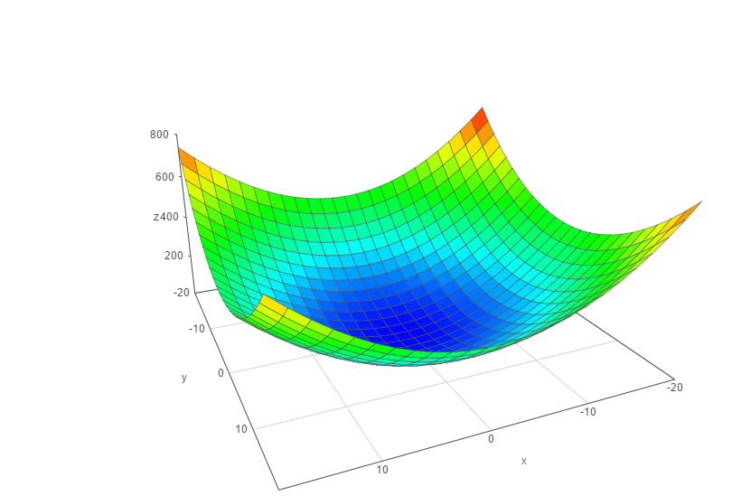




Gradient Descent
We have to know the partial derivative of the C(b) cost function
and go to the direction of the gradient
// gradient ~ partial derivative
C(b)
$$\frac{∂C(b)}{∂b}$$
$$\frac{∂C(b)}{∂b}$$
0
1
the f(x) gradient of a given f(x) function
  is pointing in the direction of maximum
Δ
we are after the minimum: so we have to use
  - f(x) instead
Δ
b
1
make iterations {
}
b
$$\frac{∂C(b)}{∂b}$$
$$\frac{∂C(b)}{∂b}$$
0
b ← b – α
b ← b – α
0
0
1
1
0
1

Slide 12
Gradient Descent
C(b)
α: learning-rate
→ small learning-rate: the algorithm takes small
steps towards the minimum
~ takes more time to converge
→ huge learning-rate: the algorithm takes big
steps towards the minimum
~ algorithm is faster but not
as accurate
b
1
b
0

Slide 13
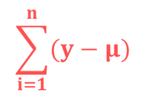


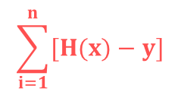
Linear Regression - Parameters
2
The R statistic is defined as follows:
2
$$\frac{RSS}{TSS}$$
// the higher the better the model fits the data
R = 1 -
measures the accuracy of the regression models
It is the square of the correlation coefficient r
~ so it measures how strong of a linear relationship is
between two variables !!!
RSS - „residual sum of squares”
Measures the variability left unexplained after performing the regression
TSS - „total sum of squares”
  It measure the total variance in y
$$\sum_{i=1}^{n}{[H(x)−y]}$$
2
$$\frac{1}{n}$$
$$\sum_{i=1}^{n}{(y−μ)}$$
2

