Slide 1
Pruning and Bagging
What is the aim when dealing with machine learning algorithms? We want to choose
a model that capture the relatinships within the training dataset
+ generalizes well to unseen data (test set)
GENERALLY IT IS IMPOSSIBLE TO ACHIEVE BOTH OF THEM AT THE SAME TIME
~ this is called the bias-variance trade-off

Slide 2
Pruning and Bagging
bias: error from misclassifications in the learning algorithm
High bias → the algorithm misses the relevant relationships
between features and target outputs (underfitting)
ERROR DUE TO MODEL MISMATCH
variance: error from sensitivity to small changes in the training set
High variance → can cause overfitting (the algorithm models the noise)
VARIATION DUE TO TRAINING SAMPLE AND RANDOMIZATION
bias / variance trade-off
~ we are not able to optimize both bias and variance at the same time
low bias → high variance
low variance → high bias

Slide 3
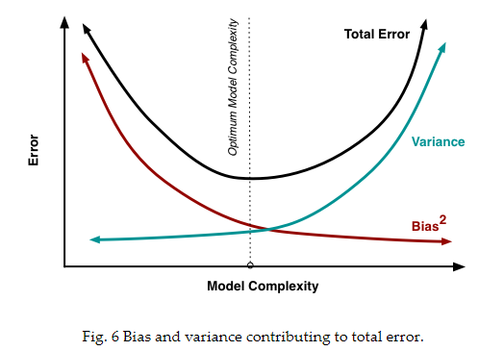
Pruning and Bagging
http://scott.fortmann-roe.com/docs/BiasVariance.html

Slide 4
Pruning
usually decision trees are likely to overfit the data leading to poor test performance
+ trees are unstable classifiers: if you perturb the data a little the tree might significantly change
(low bias but high variance model !!!)
smaller tree + fewer splits → better predictor at the cost of a little extra bias
better solution: grow a large tree and then prune it back to a smaller subtree
„weakest link pruning”

Slide 5
Pruning
BEFORE PRUNING

Slide 6
Pruning
AFTER PRUNING

Slide 7
Bagging
BOOTSTRAP AGGREGATION
A rather counter-intuitive theory: a weak learner is not able to make
good predictions
→ weak learner is just a bit better than random guess or coin flip
For example: decision trees with depth 1
→ combining weak learners can prove to be an extremely
powerful classifier !!!
„wisdom of the crowd”
(Black-Scholes model is approximately the same: two risky
positions taken together can effectively eliminate risk itself)

Slide 8
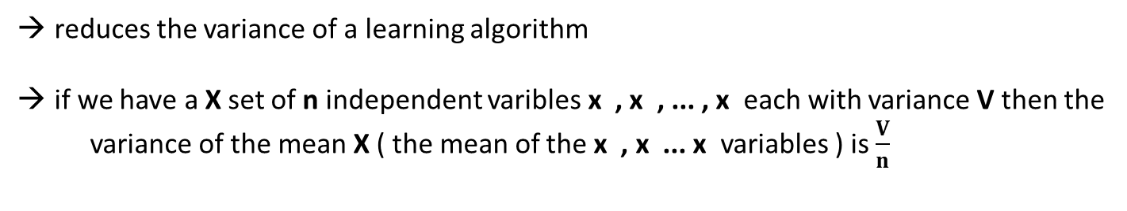
Bagging
BOOTSTRAP AGGREGATION
reduces the variance of a learning algorithm
if we have a X set of n independent varibles x , x , ... , x each with variance Vthen the
variance of the mean X ( the mean of the x , x ... x variables ) is $\frac{V}{n}$
1
2
n
1
2
n
WE CAN REDUCE THE VARIANCE BY AVERAGING A SET OF OBSERVATIONS !!!
good idea: have multiple training sets and construct a decision tree (without pruning)
on every single training set !!!
→ PROBLEM: we do not have several training sets

Slide 9
Bagging
BOOTSTRAP AGGREGATION
we should take repeated samples from the single data set + construct trees + average
all the predictions in the end
~ all the trees are fully grown unpruned decision trees
THIS IS CALLED BAGGING !!!
pruning: variance decreases but we have some bias ... here we can reduce
the variance without extra bias
Regression problem: we take the average
Classification problem: we take the majority vote

Slide 10
Bagging
BOOTSTRAP AGGREGATION
One problem with bagging: the constructed trees are highly correlated
Why do correlation occur?
Because every dataset has a strong predictor/feature. All the bagged trees
tend to make the same splits because they all share the same features !!!
~ because of this all of these trees look very similar
TREE #1
TREE #2
TREE #3
TREE #4
CORRELATED TREES BECAUSE WE USE ALL THE FEATURES

Slide 11
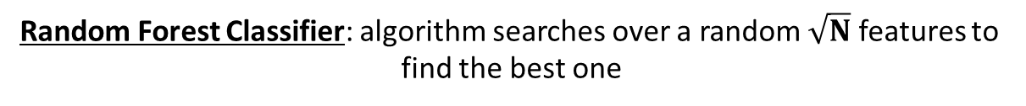
Random Forest Classifier
better than bagging: this algorithm decorrelates the single decision trees that has been constructed
this reduces the variance even more when averaging the trees
similar to bagging: we keep constructing decision trees on the training data BUT on every split in the tree, a random selection of features / predictors is chosen from the full feature set
The number of features considered at a given split is approximately equal to the square root of the total number of features (for classification)
Bagging: algorithm searches over all the N features to find
the best feature that best splits the data at that node
Random Forest Classifier: algorithm searches over a random $\sqrt{N}$ features to
find the best one

Slide 12
Random Forest Classifier
X dataset
N features
N features
N features
N features
1
2
3
4
TREE #1
TREE #2
TREE #3
TREE #4
CLASS C
CLASS D
CLASS B
CLASS C
MAJORITY VOTING
FINAL CLASS

Slide 13
Random Forest Classifier
Why is it good?
if one or a few features are very strong predictors for the response variable (target output), these features will be selected in many of the decision trees: so they will become correlated
huge advantage: at some point the variance stops decreasing no matter how many more trees we add to our random forest + it is not going to produce overfitting !!!

