Slide 1
Decision Trees
Decision Tree is a type of supervised learning approaches: mostly used in classification
problems but it can be used for regression as well
~ works fine for both categorical variables and continuous input as well
→ very similar to search trees
→ split the data/population into two or more homogeneous sets
based on significant splitter in input variables

Slide 2
Decision Trees
Decision Tree is a type of supervised learning approaches: mostly used in classification
problems but it can be used for regression as well
~ works fine for both categorical variables and continuous input as well
→ very similar to search trees
→ split the data/population into tow or more homogeneous sets
based on significant splitter in input variables
For example: we have a single
feature x, the number of hours a
student spent with studying
Want to predict the y probability
of passing the exam
we split on x
x < 5
x > 5
Categorical Variable Decision Tree:
→ categorical target variable such as yes/no or fail/pass
Continuous Variable Decision Tree:
→ continuous target variable: such as for regression
FAIL
PASS

Slide 3
Decision Trees
root node: represent the entire dataset/population and this
further gets divided into several subsets
~ root node corresponds to the best predictor
decision node: the algorithm splits the
node into sub-nodes based on given
feature in the dataset
leaf nodes: with no children
~ the values are what we are after
HOW TO DECIDE WHAT NODES (FEATURES) ARE IMPORTANT?
WHAT SHOULD BE THE ROOT NODE?

Slide 4
Decision Trees
Decision Tree classifier accuracy depends heavily on splits
Hot to construct the tree? What are the nodes?
There are several algorithms for this problem:
1.) Gini Index Approach
2.) Calculating the information entropy (ID3 algorithm or C4.5 approach)
3.) algorithm based on variance reduction

Slide 5
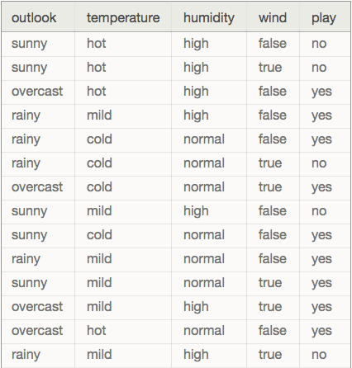
Decision Trees
We are dealing with categorical variables (predictors)
or features: outlook, temperature, humidity, wind
~ we want to predict whether to play
golf or not (play is he target variable)

Slide 6
Decision Trees
OUTLOOK
SUNNY
OVERCAST
RAINY
WINDY
YES
HUMIDITY
TRUE
FALSE
HIGH
NORMAL
YES
NO
NO
YES

Slide 7
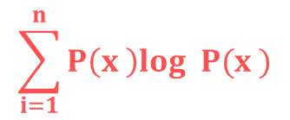
Decision Trees
Usually ID3 algorithm is used to build the decision tree:
~ it is a top-down greedy search of possible branches
→ it uses entropy and information gain to build the tree
The H(X) Shannon-entropy of a dicrete random variable X with possible values
x x ... x and probability mass function P(X) is defined as:
1
2
n
$$\sum_{i=1}^{n}{P\left(x \right)log P(x )}$$
H(X) = -
i
2
i
Example: https://en.wikipedia.org/wiki/Entropy_(information_theory)
For completely homogoeneous dataset (all TRUE or all FALSE values): entropy is 0
If the dataset is equally divided (same amount of TRUEs and FALSEs): entropy is 1
A BRANCH WITH ENTROPY MORE THAN 1 NEEDS SPLITING !!!
+ root node has the maximum information gain (entropy reduction)
+ leaf nodes have entropy 0

Slide 8
Decision Trees
PLAYING GOLF
→ 9 times YES
→ 5 times NO
We just have to use the Shannon-entropy formula
to calculate the H(x) values
H(PlayingGolf) = H(9,5) =
= -(0.64 log 0.64) – (0.36 log 0.36) = 0.94
2
2

Slide 9
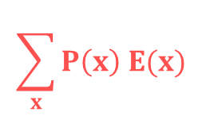
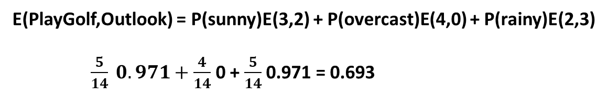
Decision Trees
$$\sum_{x}{P\left(x\right) E(x)}$$
E(T,X) =
We have to calculate the entropy with respect to
a given predictor/feature in order to be able to
calculate information gain
PLAY GOLF
YES NO
sunny 3 2
overcast 4 0
rainy 2 3
OUTLOOK
E(PlayGolf,Outlook) = P(sunny)E(3,2) + P(overcast)E(4,0) + P(rainy)E(2,3)
$\frac{5}{14} 0.971+\frac{4}{14}$ 0 + $\frac{5}{14}$ 0.971 = 0.693

Slide 10
Decision Trees
Information gain: the decrease in entropy after a dataset is
split on an attribute/feature
→ feature/attribute with the highest information
gain will be the root node in the tree
Information Gain = H(PlayGolf) - E(PlayGolf,Outlook) =
= 0.64 – 0.693 = 0.247
PLAY GOLF
YES NO
sunny 3 2
overcast 4 0
rainy 2 3
OUTLOOK

Slide 11
Decision Trees
Information gain: the decrease in entropy after a dataset is
split on an attribute/feature
→ feature/attribute with the highest information
gain will be the root node in the tree
Information Gain (outlook) = 0.247
Information Gain (temperature) = 0.029
Information Gain (humidity) = 0.152
Information Gain (wind) = 0.048

Slide 12
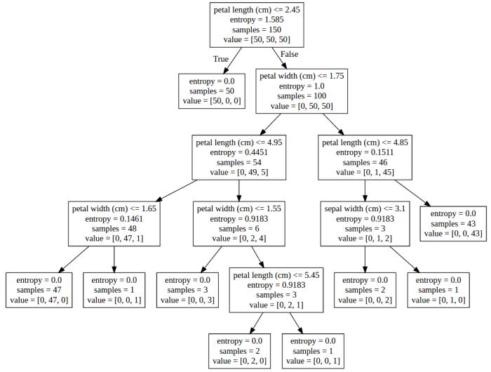
Decision Trees
IRIS-SETOSA
IRIS-VERSICOLOR
IRIS-VIRGINICA

Slide 13
Decision Trees
Most significant problem: every split it makes at each node is
optimized for the dataset it is fit to
~ this splitting process will rarely generalize well to other data !!!

Slide 14
Decision Trees
ADVANTAGES
easy to understand and interpret
it is one of the best approaches to identify most significant variables
  and the relationships between the variables
no need for data preprocessing
Decision trees are not influenced by outliers for example
can handle numerical variables as well as categorical variables
  Categorical variables: YES/NO or SUNNY/RAINY
DISADVANTAGES
have the tendency to overfit
  ~ we can solve it by pruning for example
decision trees can be unstable because small variations in the data might
  result in a completely different tree being generated
~ generating the optimal tree is NP-complete: heuristic solutions are used (greedy approach)

Slide 15
Gini Index Approach
CART (Classification and Regression Tree) algorithm uses Gini indexes to
decide how to make the splits
using Gini Index Approach is a bit better than
calculating the information gain and entropy
THE ALGORITHMS ARE APPROXIMATELY THE SAME !!!
when dealing with entropy: we have to calculate logarithmic
  functions, which are computationally expensive
  ~ thats why we prefer Gini Index Approach

Slide 16

Gini Index Approach
$$\sum_{i=1}^{n}{P\left(x \right)}$$
G(X) = 1 -
2
i
This is the formula we have to use in order to calculate
the Gini-index of a X random variable
E(s,t) = G(t) – P(left) G(left_t) – P(right) G(right_t)
As we have seen for Information Gain, here as well we have to calculate
the Gini-index concerning a given split
WE SPLIT THE FEATURE WITH THE LOWEST GINI-INDEX

Slide 17
Gini Index Approach
PLAYING GOLF
→ 9 times YES
→ 5 times NO
We just have to use the Gini-index formula
to calculate the G(x) values
G(PlayingGolf) = G(9,5) =
= 1 - 0.64 - 0.36 = 0.46
2
2

Slide 18


Gini Index Approach
E(s,t) = G(t) – P(left) G(left_t) – P(right) G(right_t)
Gini-index for
input node t
proportion of observation
in the left node after splitting
+ Gini-index of the left node
after splitting
proportion of observation
in the right node after splitting
+ Gini-index of the right node
after splitting
DEFAULT
YES NO
GENDER
male 3 2
female 4 0
$$(\frac{7}{9})$$
$$(\frac{2}{9})$$
2
2
G(t) = 1 - - = 0.3432

Slide 19






Gini Index Approach
E(s,t) = G(t) – P(left) G(left_t) – P(right) G(right_t)
Gini-index for
input node t
proportion of observation
in the left node after splitting
+ Gini-index of the left node
after splitting
proportion of observation
in the right node after splitting
+ Gini-index of the right node
after splitting
DEFAULT
YES NO
GENDER
male 3 2
female 4 0
$$(\frac{3}{5})$$
$$(\frac{2}{5})$$
2
2
G(male) = 1 - - = 0.48
$$(\frac{4}{4})$$
$$(\frac{0}{4})$$
2
2
G(female) = 1 - - = 0
$$\frac{5}{9}$$
$$\frac{4}{9}$$
E(s,t) = 0.34 – 0.48 - 0 = 0.07

